Slide 1
Video Translation Software

Slide 2
INDEX
Abstract
Objective of project
Problem Statement
Scope & Motivation
Introduction
Literature survey
Existing Method
Disadvantages
Proposed method
Advantages
Project Flow
Hardware and Software Requirements
Modules
Methodology/algorithm
UMLS
Output screens
Conclusion
Future enhancement
References

Slide 3
ABSTRACT
This project endeavors to develop a sophisticated software solution aimed at facilitating the translation of videos from English to various languages spoken in India, encompassing diverse religious and cultural backgrounds. The primary objective is to bridge linguistic gaps and promote inclusivity by making video content accessible and comprehensible to a wider audience.
Key features of the software include user-friendly interfaces, efficient video processing capabilities, and support for multiple Indian languages. The development process involves the integration of cutting-edge technologies such as neural machine translation and robust language models.
The anticipated impact of this project is significant, contributing to the democratization of information and fostering cross-cultural understanding. By enabling the translation of videos into languages associated with different religions, the software aspires to promote cultural harmony and facilitate the sharing of diverse perspectives.
Keywords: Video Translation, Machine Translation, Deep Learning, Natural Language Processing, Cross-Cultural Communication.

Slide 4
PROBLEM STATEMENT
The project addresses the challenge of bridging linguistic and cultural gaps in video content by developing software for accurate translation from English to various languages representing different religions in India. The problem lies in the limited availability of tools catering to diverse linguistic needs, hindering the accessibility and understanding of content across different communities. This project aims to overcome these barriers and provide a solution that promotes inclusivity and cultural sensitivity in video communication.

Slide 5
OBJECTIVE OF THE PROJECT
The project aims to develop user-friendly software for translating videos from English to various languages associated with different religions in India. The primary objectives include implementing advanced machine translation techniques, ensuring precise translations, supporting multiple video formats, and promoting cross-cultural communication. The software emphasizes linguistic diversity, cultural understanding, and the democratization of information through cutting-edge technologies and user-friendly interfaces.

Slide 6
SCOPE
Language Coverage: The software aims to support translation into languages associated with different religions in India, ensuring broad coverage to accommodate diverse linguistic preferences.
User-Friendly Interface: The development of a user-friendly interface is a crucial aspect of the project's scope. The software should be intuitive and easily navigable, allowing users to seamlessly interact with the budding process.
Translation Accuracy: The project places importance on the accuracy of translation. Efforts will be directed towards leveraging advanced language processing techniques to ensure the faithful translation of video content.
Cultural Sensitivity: Cultural nuances and sensitivities will be considered during the translation process to maintain the integrity and appropriateness of the content across different linguistic and cultural contexts.
Scalability: The software will be designed with scalability in mind, allowing for the addition of new languages and features in future updates. This ensures that the tool remains relevant and adaptable to evolving linguistic landscapes.

Slide 7
SCOPE
Community Feedback Integration: The project scope involves mechanisms for gathering user feedback to continually improve the software. This iterative process aims to address user needs and preferences, enhancing the overall user experience.
Resource Efficiency: Efficient resource utilization, both in terms of computational resources and translation processing time, is a critical consideration. The software should deliver timely translations without excessive resource demands.
Security and Privacy: The scope extends to implementing robust security measures to safeguard user data and maintain privacy during the translation process. Compliance with data protection regulations will be prioritized.
Educational Outreach: As part of the broader scope, there may be opportunities for educational outreach programs to raise awareness about the software's capabilities and promote its usage among different communities.
Integration with Existing Platforms: Exploring possibilities for integration with existing video-sharing platforms or applications is within the project scope. This could enhance the software's reach and impact.

Slide 8
MOTIVATION
Multilingual Accessibility: Enable individuals from diverse linguistic backgrounds in India and other regions to access video content in their native languages, fostering inclusivity.
Cultural Bridging: Address the challenge of linguistic and cultural barriers by providing a tool that facilitates the translation of videos into languages associated with different religions and cultures.
Community Empowerment: Empower communities by enabling them to engage with content that reflects their cultural and linguistic identities, promoting a sense of belonging and representation.
Enhancing Communication: Contribute to improved communication and understanding among people of various linguistic and religious backgrounds, fostering mutual respect and harmony.
Promoting Inclusivity: Tackle the issue of language-related exclusion in media by creating a software solution that promotes inclusivity and equal access to information and entertainment.

Slide 9
INTRODUCTION
The advent of globalization and digital connectivity has led to an unprecedented influx of content consumption across diverse linguistic and cultural landscapes. However, this surge in digital content is not always accessible or relatable to individuals whose primary language and cultural context differ from the content's origin. In this context, the project emerges as a response to the growing need for a sophisticated software solution that seamlessly translates and buds videos from English to various Indian languages, with a specific emphasis on accommodating religious nuances.
Understanding the multifaceted nature of linguistic diversity in India, the software goes beyond mere translation. It employs advanced budding algorithms to ensure a smooth and contextually appropriate transition between segments of the video content. Moreover, the software recognizes the importance of religious sensitivity in language translation, particularly when dealing with content related to diverse religions. As such, it incorporates mechanisms to handle religious terminologies with respect and accuracy, enhancing the overall quality of the translated content.

Slide 10
INTRODUCTION
One of the distinguishing features of the software is its user-centric approach. It provides users with the flexibility to customize the budding process based on their preferences, allowing for a personalized and culturally sensitive viewing experience. By placing control in the hands of the users, the software aims to cater to individual preferences and ensure that the translated content aligns with their cultural and religious backgrounds.
In essence, this project is not merely a technological solution but a cultural bridge that facilitates a deeper understanding and appreciation of content across linguistic and religious boundaries. As we delve into the project's development and functionalities, it becomes evident that it addresses a significant gap in the digital content landscape, contributing to cultural inclusivity and technological innovation.

Slide 11
LITERATURESURVEY
Author and Year | Title | Proposed | Outcomes
Felix Stahlberg: | Neural Machine Translation: A Review | Journal of Artificial Intelligence Research (JAIR), (2020) | SMT to NMT transition in machine translation marks a paradigm shift, leveraging neural networks for improved accuracy and contextual understanding. Encoder-decoder architectures and embeddings play pivotal roles, enhancing language translation effectiveness.
Markus Freitag, Orhan Firat | Complete Multilingual Neural Machine Translation | arXiv:2010.10239, (2020) | The experiments and analysis demonstrate that cMNMT, with up to 12,432 language pairs, achieves competitive translation quality across all language pairs. The research highlights the effectiveness of leveraging multi-way aligned examples and introduces a scalable model that enhances translation capabilities in multilingual scenarios.

Slide 12
Author and Year | Title | Proposed | Outcomes
Alexandre Berard, Olivier Pietquin, Christophe Servan, Laurent Besacier | Listen and Translate A Proof of Concept for End-to-End Speech-to-Text Translation. | arXiv, (2016) | The outcomes of this research suggest that end-to-end approaches for speech-to-text translation have the potential to reshape data collection practices. The proposed model opens avenues for collecting data by having bilingual speakers articulate speech directly in the source language corresponding to target language text utterances. This shift in approach is particularly advantageous for languages without standardized spelling or written forms.
Surangika Ranathunga, En-Shiun Annie Lee, Marjana Prifti Skenduli, Ravi Shekhar, Mehreen Alam, Rishemjit Kaur | Neural Machine Translation for Low-resource Languages | arXiv, (2023) | The outcomes of this survey shed light on the evolving landscape of NMT, particularly in the context of low-resource languages. By synthesizing current research trends, the article contributes to the identification of effective NMT techniques for diverse LRL data scenarios. The recommendations presented aim to inspire continued research efforts, fostering advancements in addressing the unique challenges posed by low-resource language pairs in the realm of Neural Machine Translation.

Slide 13
EXISTING METHOD
The conventional approach to video translation involved manual processes, including hiring translators, synchronizing translations with video content, and addressing cultural nuances. This method faced challenges such as high costs, time consumption, and scalability issues, hindering timely and efficient translation.
Limitations:
Manual Translation: Labor-intensive and time-consuming manual translation processes.
Synchronization Challenges: Difficulty in achieving perfect synchronization of translated text with video scenes.
Cultural Adaptation: Requirement for careful consideration of cultural nuances during translation.
Limited Scalability: Inability to easily scale for multiple languages or a large volume of content.

Slide 14
EXISTING METHOD
High Costs: Financial burden associated with human translation services.
Time-Consuming: Delays in the delivery of translated content affecting timely releases.
Quality Control: Challenges in maintaining consistent translation quality across diverse contexts.
Proposed Improvements:
The proposed software aims to revolutionize video translation by introducing automation, scalability, real-time capabilities, and a user-friendly interface. This innovative approach addresses existing limitations, making video translation more efficient, accessible, and adaptable to diverse linguistic and cultural contexts.

Slide 15
DISADVANTAGES
Manual Feature Engineering: Traditional methods often require the manual extraction and selection of audio features, which can be time-consuming and may not capture all relevant information in complex audio data.
Limited Adaptability: These methods may have limited adaptability to varying audio patterns and may struggle to generalize well to diverse sound environments.
Labeling and Data Requirements: Traditional approaches heavily rely on labeled datasets for supervised learning, which can be expensive and time-intensive to create, especially for large-scale applications.
Difficulty with Noisy Data: Handling noisy or unstructured audio data is challenging for traditional methods, as they may not effectively filter out irrelevant information or cope with background noise.
Suboptimal Performance: In comparison to deep learning models like CNN, MobileNet, and ResNet, traditional approaches may achieve suboptimal performance, particularly when dealing with large and complex audio datasets.

Slide 16
PROPOSED SYSTEM
The software aims to revolutionize video translation from English to various Indian languages. Key features include advanced language processing for accuracy, a user-friendly interface, support for multiple languages, real-time translation, adaptive language models, platform compatibility, and robust privacy measures. The agile development approach ensures continuous improvement and user satisfaction.

Slide 17
ADVANTAGES
Accurate Language Processing: The software utilizes advanced language processing algorithms, ensuring precise and contextually relevant translations.
User-Friendly Interface: A seamless and intuitive interface allows users to navigate and use the software effortlessly, promoting accessibility.
Multi-Language Support: The software supports translation into various Indian languages, facilitating broader audience reach and cultural inclusivity.
Real-Time Translation: Real-time translation capabilities enable users to experience immediate language conversion during video playback.
Adaptive Language Models: The software employs adaptive language models, continuously learning and improving translation accuracy over time.
Platform Compatibility: Designed to be compatible with multiple platforms, users can access the software on diverse devices, enhancing convenience.
Robust Privacy Measures: Stringent privacy measures are implemented to safeguard user data, ensuring a secure and confidential translation experience.

Slide 18
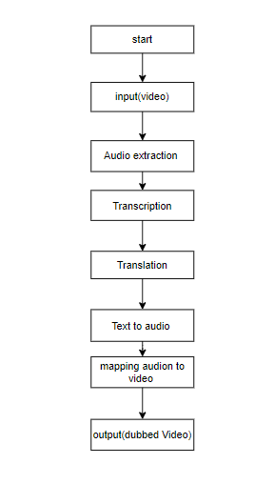
PROJECT FLOW

Slide 19
HARDWARE AND SOFTWARE REQUIREMENTS
HARDWARE REQUIREMENTS
Processor - I3/Intel Processor
Hard Disk - 160GB
Key Board - Standard Windows Keyboard
Mouse - Two or Three Button Mouse
Monitor - SVGA
RAM - 8GB
SOFTWARE REQUIREMENTS:
Operating System : Windows 7/8/10
Server side Script : HTML, CSS, Bootstrap & JS
Programming Language : Python
Libraries : Flask, Pandas, Pandas, Librosa,, GTTS, moviepy, speech_recognition, googletrans
IDE/Workbench : VSCODE
Technology : Python 3.6+
Server Deployment : Xampp Server
Database : MySQL

Slide 20
Modules
1. System:
1.1 Data Collection:
- Gather videos in English and corresponding scripts.
- Organize and store the data for further processing.
1.2 Preprocessing:
- Clean and preprocess the video and script data.
- Handle missing information and ensure data quality.
1.3 Translation Integration:
- Implement translation services for converting English scripts to Indian languages.
- Integrate translation outputs with corresponding video segments.

Slide 21
Modules
1.4 Video Budding:
- Develop algorithms for intelligently segmenting and budding videos.
- Ensure smooth transitions and coherence in the budding process.
1.5 Quality Assurance:
- Implement checks to maintain video and audio quality during the budding process.
- Address any issues related to translation artifacts or distortions.
1.6 User Feedback Mechanism:
- Integrate a feedback system for users to provide input on translation accuracy and video quality.
- Utilize feedback to enhance the translation and budding algorithms.

Slide 22
Modules
2. User:
2.1 Video Upload:
- Provide a user-friendly interface for uploading English videos.
- Ensure compatibility with various video formats.
2.2 Language Selection:
- Allow users to choose the desired Indian language for translation.
- Provide options for multiple language selections if needed.
2.3 Translation Preview:
- Offer users a preview of the translated scripts before finalizing the budding process.
- Ensure user satisfaction with the translation outputs.

Slide 23
Modules
2.4 Budding Customization:
- Allow users to customize the budding process based on preferences.
- Options may include choosing specific translation styles or segment durations.
2.5 Output Access:
- Enable users to access and download the translated and budded videos.
- Ensure a seamless viewing experience with appropriate playback controls.
2.6 User Analytics:
- Implement analytics to gather user preferences and usage patterns.
- Utilize analytics for continuous improvement and feature enhancements.

Slide 24
Methodology
1. Data Collection:
Diverse Dataset: Gather a comprehensive dataset comprising videos representing different content genres, linguistic styles, and cultural contexts.
Audio Variation: Include videos with diverse audio characteristics, such as accents, intonations, and expressions, to capture the richness of language.
2. Audio Extraction:
Tools and Techniques: Utilize audio extraction tools to separate the audio streams from the collected videos.
Quality Check: Ensure the extracted audio maintains high quality and fidelity.
3. Audio Transcription:
Automatic Speech Recognition (ASR): Employ ASR techniques to transcribe the extracted audio into textual format.
Model Consideration: Choose between pre-trained ASR models or consider training custom models based on the dataset characteristics.

Slide 25
Methodology
4. Text Language Detection:
Algorithm Implementation: Implement language detection algorithms to identify the source language (English) of the transcribed text.
Religious Context: Develop language detection mechanisms sensitive to religious terms and expressions.
5. Text Translation:
Machine Translation: Use machine translation algorithms to translate the transcribed English text into the desired Indian languages.
Religious Terminology: Implement specialized translation modules for accurate rendering of religious terminology.
6. Text-to-Speech (TTS):
TTS Synthesis: Convert the translated text into speech using Text-to-Speech synthesis.
Customization: Customize the TTS system to reflect appropriate intonations, expressions, and cultural nuances, especially in the context of religious content.

Slide 26
Methodology
7. Mapping of Audio to Video:
Integration: Integrate the translated audio back into the original video content.
Synchronization: Apply mapping techniques to synchronize specific audio segments with corresponding video scenes, ensuring coherence and context.
8. Software Implementation:
User Interface: Develop a user-friendly interface that guides users through the entire budding process.
Customization Features: Implement features allowing users to specify language preferences, select translation nuances, and adjust text-to-speech characteristics.
9. Quality Assurance:
Testing: Conduct rigorous testing to ensure accuracy in audio extraction, transcription, translation, and synchronization.
Linguistic Nuances: Address potential issues related to linguistic nuances, religious terminology, and the coherence of audio-visual elements.

Slide 27
Methodology
10. User-Centric Customization:
Fine-Tuning Options: Empower users with the ability to fine-tune the budding process based on their linguistic, cultural, and religious preferences.
Iterative Feedback: Gather user feedback on the translated content and implement iterative improvements to enhance user satisfaction.

Slide 28
UML DIAGRAMS
UML stands for Unified Modelling Language. UML is a standardized general-purpose modelling language in the field of object-oriented software engineering. The standard is managed, and was created by, the Object Management Group.
The goal is for UML to become a common language for creating models of object-oriented computer software. In its current form UML is comprised of two major components: a Meta-model and a notation. In the future, some form of method or process may also be added to; or associated with, UML.
The Unified Modelling Language is a standard language for specifying, Visualization, Constructing and documenting the artifacts of software system, as well as for business modelling and other non-software systems.
The UML represents a collection of best engineering practices that have proven successful in the modelling of large and complex systems.
The UML is a very important part of developing objects-oriented software and the software development process. The UML uses mostly graphical notations to express the design of software projects.

Slide 29
USE CASE DIAGRAM
A use case diagram in the Unified Modeling Language (UML) is a type of behavioral diagram defined by and created from a Use-case analysis. Its purpose is to present a graphical overview of the functionality provided by a system in terms of actors, their goals (represented as use cases), and any dependencies between those use cases. The main purpose of a use case diagram is to show what system functions are performed for which actor. Roles of the actors in the system can be depicted.

Slide 30
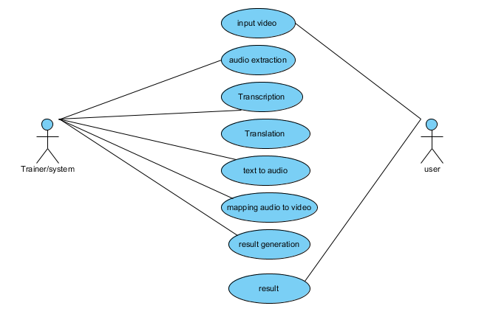

Slide 31
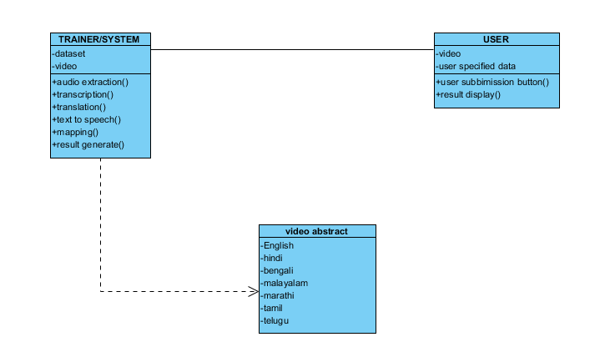
CLASS DIAGRAM
In software engineering, a class diagram in the Unified Modeling Language (UML) is a type of static structure diagram that describes the structure of a system by showing the system's classes, their attributes, operations (or methods), and the relationships among the classes. It explains which class contains information

Slide 32
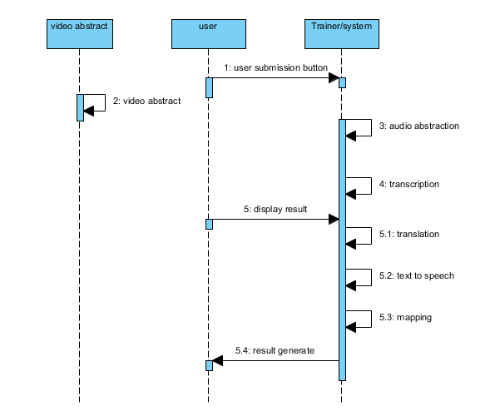
SEQUENCE DIAGRAM
A sequence diagram in Unified Modeling Language (UML) is a kind of interaction diagram that shows how processes operate with one another and in what order.
It is a construct of a Message Sequence Chart. Sequence diagrams are sometimes called event diagrams, event scenarios, and timing diagrams

Slide 33
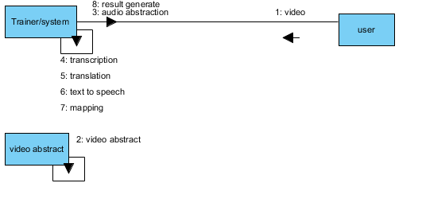
COLLABORATION DIAGRAM:
In collaboration diagram the method call sequence is indicated by some numbering technique as shown below. The number indicates how the methods are called one after another. We have taken the same order management system to describe the collaboration diagram. The method calls are similar to that of a sequence diagram. But the difference is that the sequence diagram does not describe the object organization whereas the collaboration diagram shows the object organization.

Slide 34
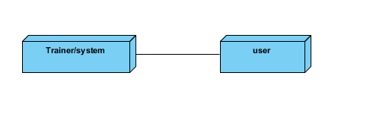
DEPLOYMENT DIAGRAM
Deployment diagram represents the deployment view of a system. It is related to the component diagram. Because the components are deployed using the deployment diagrams. A deployment diagram consists of nodes. Nodes are nothing but physical hardware’s used to deploy the application.

Slide 35
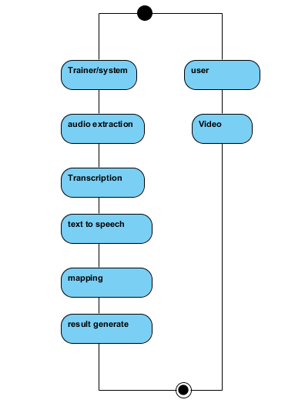
ACTIVITY DIAGRAM:
Activity diagrams are graphical representations of workflows of stepwise activities and actions with support for choice, iteration and concurrency. In the Unified Modelling Language, activity diagrams can be used to describe the business and operational step-by-step workflows of components in a system. An activity diagram shows the overall flow of control.

Slide 36
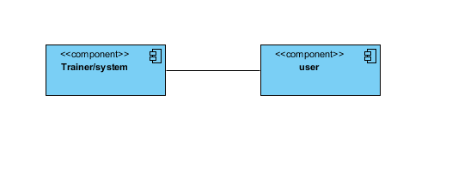
COMPONENT DIAGRAM:
A component diagram, also known as a UML component diagram, describes the organization and wiring of the physical components in a system. Component diagrams are often drawn to help model implementation details and double-check that every aspect of the system's required function is covered by planned development.

Slide 37
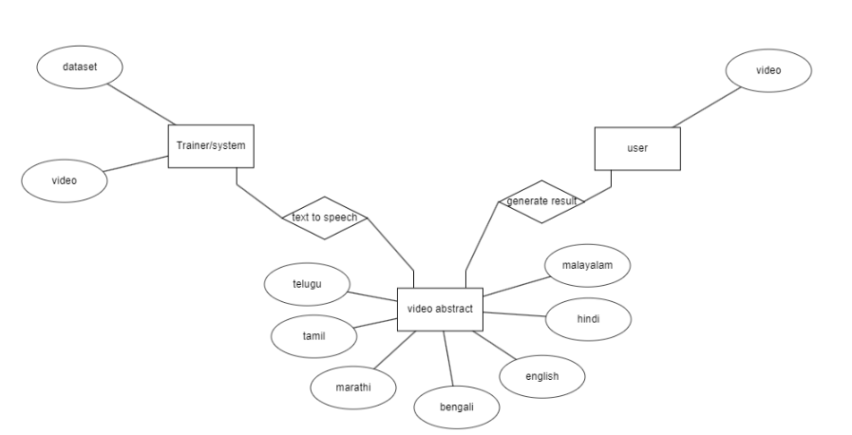
ER DIAGRAM:
An Entity–relationship model (ER model) describes the structure of a database with the help of a diagram, which is known as Entity Relationship Diagram (ER Diagram). An ER model is a design or blueprint of a database that can later be implemented as a database. The main components of E-R model are: entity set and relationship set.
An ER diagram shows the relationship among entity sets. An entity set is a group of similar entities and these entities can have attributes. In terms of DBMS, an entity is a table or attribute of a table in database, so by showing relationship among tables and their attributes, ER diagram shows the complete logical structure of a database. Let’s have a look at a simple ER diagram to understand this concept.

Slide 38
DFD DIAGRAM:
A Data Flow Diagram (DFD) is a traditional way to visualize the information flows within a system. A neat and clear DFD can depict a good amount of the system requirements graphically. It can be manual, automated, or a combination of both. It shows how information enters and leaves the system, what changes the information and where information is stored. The purpose of a DFD is to show the scope and boundaries of a system as a whole. It may be used as a communications tool between a systems analyst and any person who plays a part in the system that acts as the starting point for redesigning a system.

Slide 39
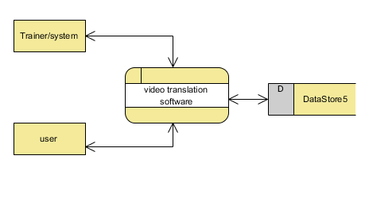
Context Diagram:

Slide 40
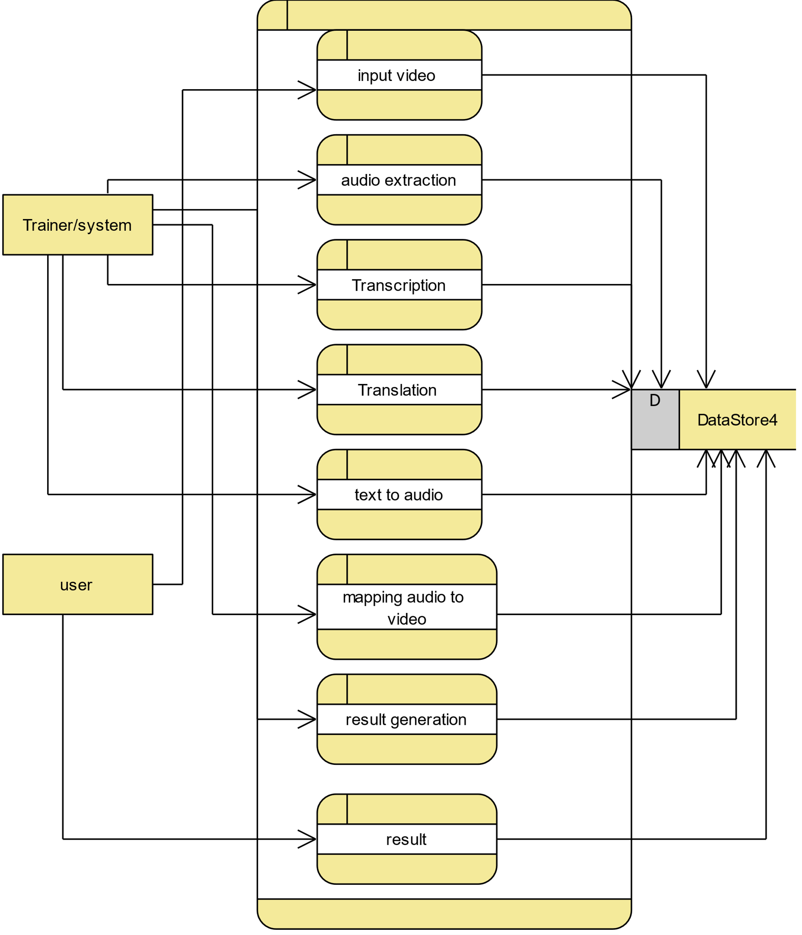
DFD Level-1 Diagram:

Slide 41
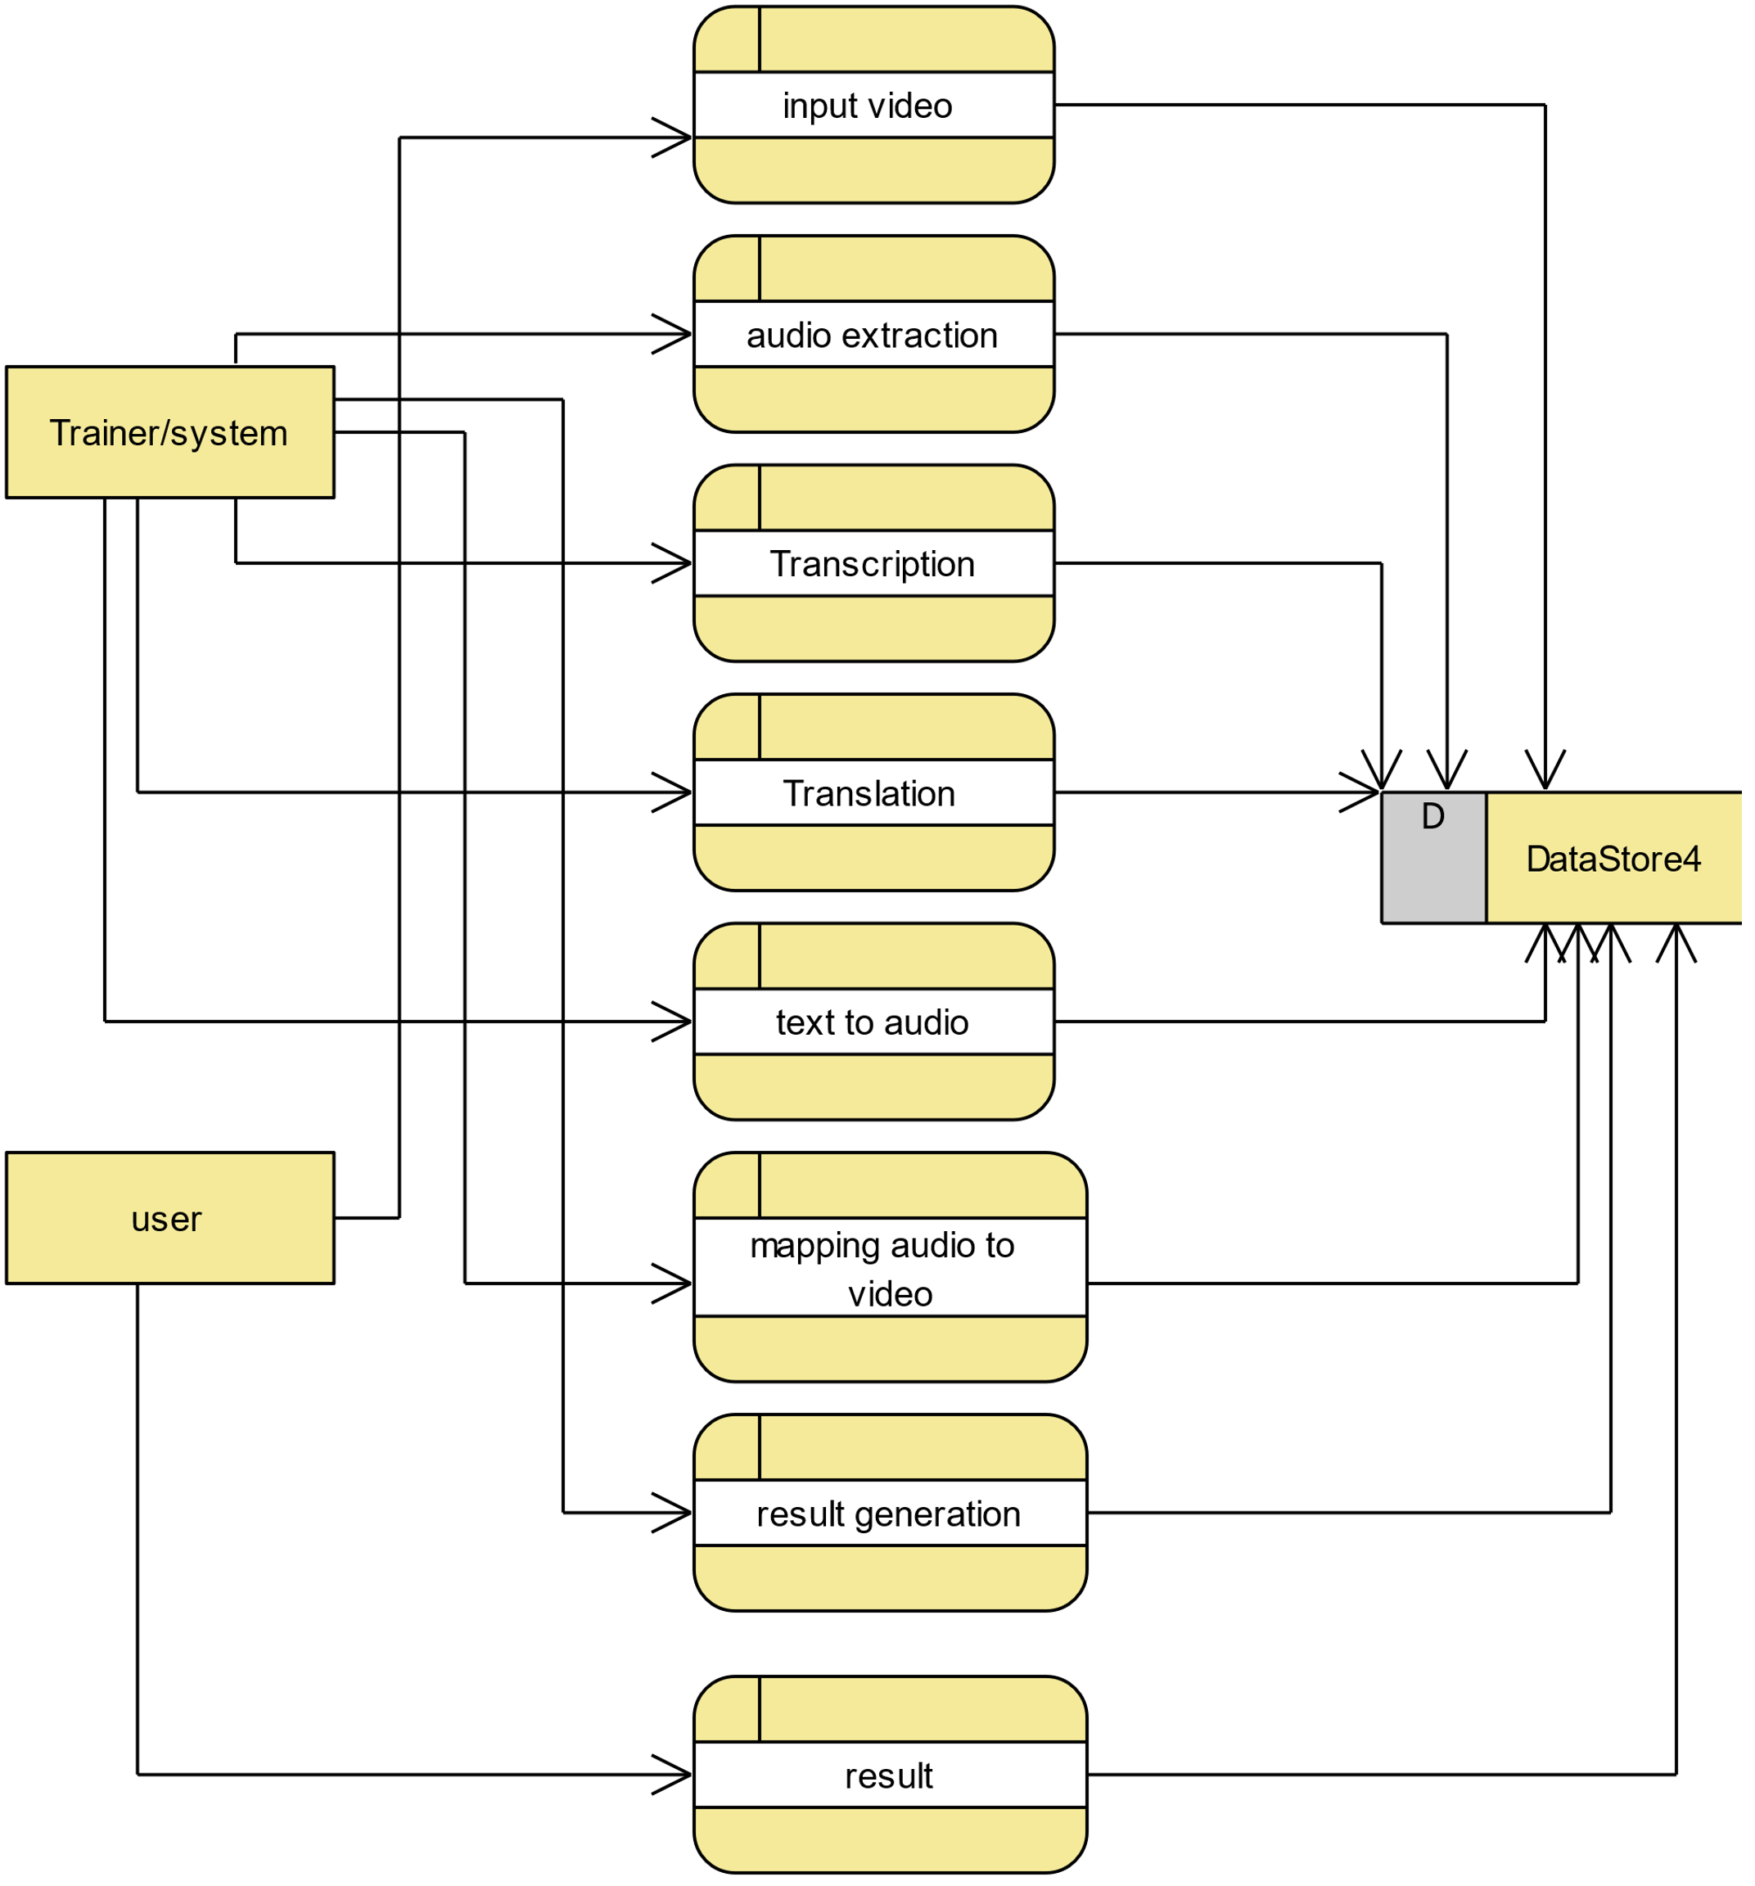
DFD Level-2 Diagram:

Slide 42
REFERENCES
[1] Felix Stahlberg (2020): Neural Machine Translation: A Review. Journal of Artificial Intelligence Research (JAIR)
[2] Markus Freitag, Orhan Firat (2020): Complete Multilingual Neural Machine Translation. arXiv:2010.10239
[3] Alexandre Berard, Olivier Pietquin, Christophe Servan, Laurent Besacier (2016): Listen and Translate A Proof of Concept for End-to-End Speech-to-Text Translation. arXiv:1612.01744
[4] Surangika Ranathunga, En-Shiun Annie Lee, Marjana Prifti Skenduli, Ravi Shekhar, Mehreen Alam, Rishemjit Kaur (2023): Neural Machine Translation for Low-resource Languages: A Survey. arXiv

